Slide 1
CONSUMER COMPLAINT DATA ANALYSIS
Presented By:
Vaishnavi Kunchala (305045798)
Khushbu Desai (305073241)
Priyal Mistry (305084512)

Slide 2
TABLE OF CONTENTS
Introduction
Specification of Dataset
Microsoft Azure HD Insight Cluster Details
Implementation
Visualization
Conclusion
References

Slide 3
INTRODUCTION
Each week, thousands of consumer’s complaints about financial protection, services or crash databases of banks are submitted to companies for response.
Data analysis help us to identify inappropriate practices and stop them before they become major issues.
The analyzed data is shown in the form of various charts and graphs using Tableau.

Slide 4
SPECIFICATION OF DATASET
Consumer complaint dataset is provided by USA government and is available on www.data.gov.
Complaints according to States, Zip codes, Products , Sub products , Company are analysed from the year 2011-2016(June).
File Size – 290MB.
Number of Files – 1.
File Format – CSV (Comma Separated Values).

Slide 5
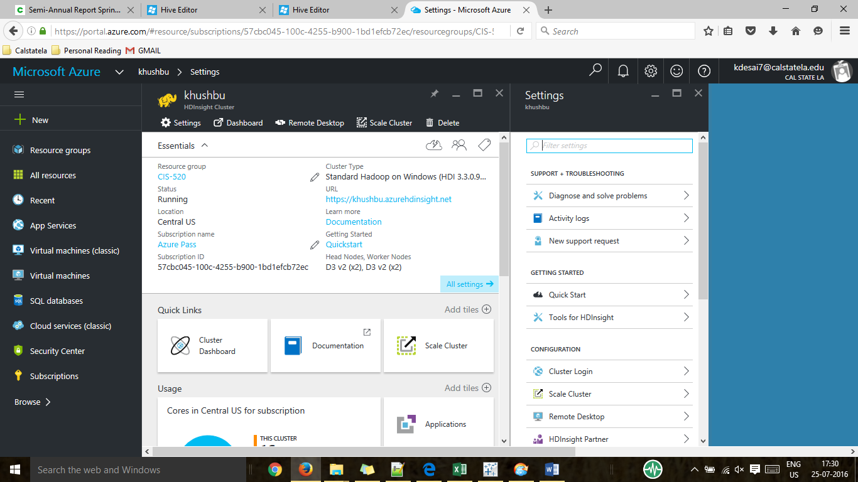
Microsoft Azure HDInsight Cluster Details
Number of nodes : 2
Operating system : Windows
Memory : 14 GB
CPU : 4 Cores

Slide 6
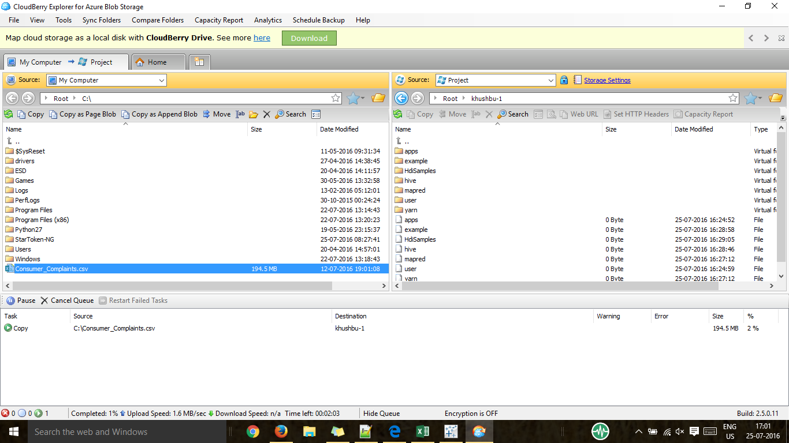
IMPLEMENTATION
Loading Data into Cloud Berry Explorer:
Cloud Berry Explorer allows accessing and managing Azure storage accounts as well as moving files and folders between your computer and cloud storage.
Data file from PC was uploaded using the 'COPY' action into the azure account using azure blob storage.

Slide 7
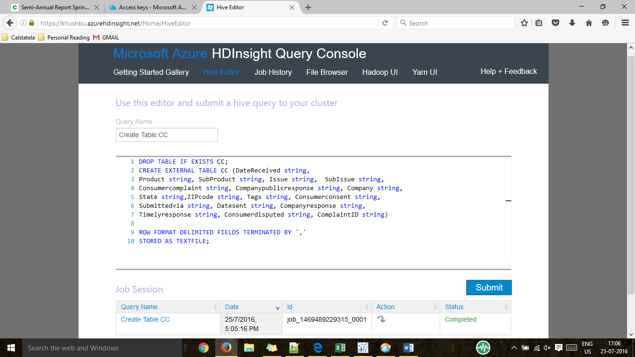
Table creation using Hive Editor
DROP TABLE IF EXISTS CC;
CREATE EXTERNAL TABLE CC (DateReceived string, Product string, SubProduct string, Issue string, SubIssue string, Consumercomplaint string, Companypublicresponse string, Company string, State string, ZIPcode string, Tags string, Consumerconsent string, Submittedvia string, Datesent string, Companyresponse string, Timelyresponse string, Consumerdisputed string, ComplaintID string)
ROW FORMAT DELIMITED FIELDS TERMINATED BY ',‘
STORED AS TEXTFILE;

Slide 8
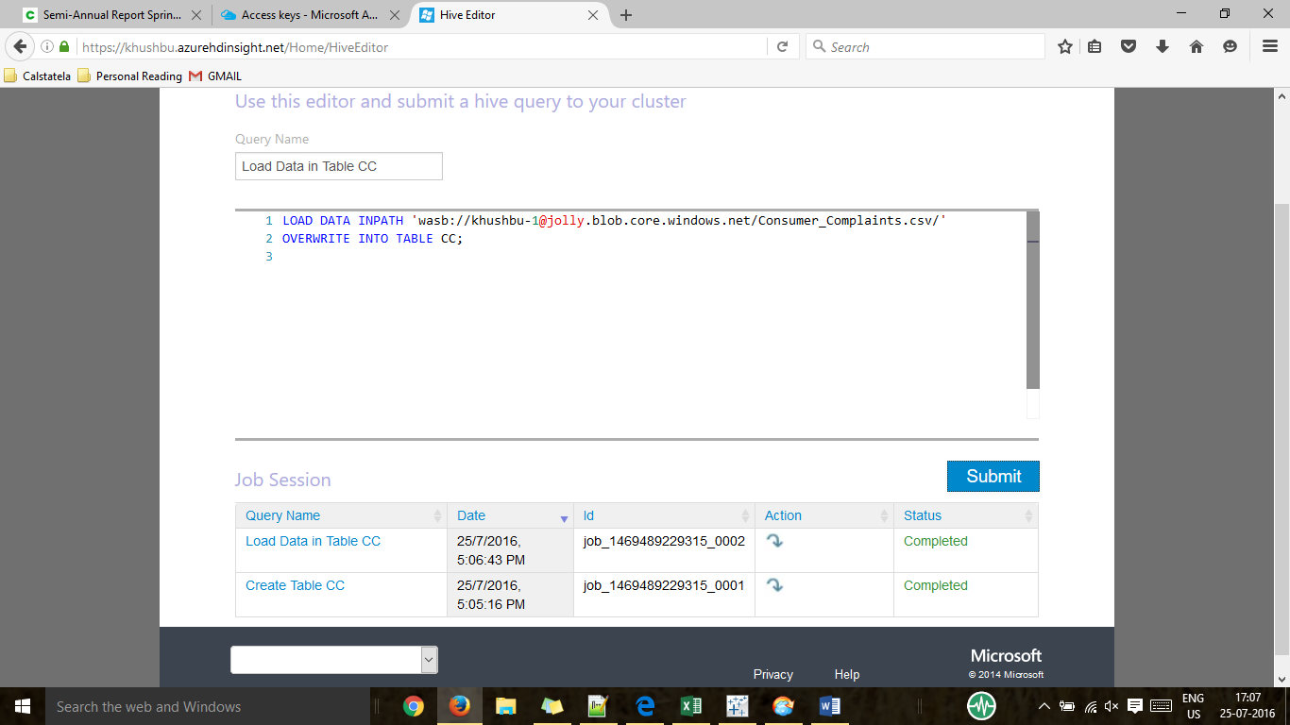
Loading Dataset in Hive Editor
LOAD DATA INPATH 'wasb://khushbu-1@jolly.blob.core.windows.net/Consumer_Complaints.csv/'
OVERWRITE INTO TABLE CC;

Slide 9
PRODUCT- WISE ANALYSIS
DROP TABLE IF EXISTS CCP;
CREATE TABLE CCP AS
SELECT Product, COUNT(Product)
FROM CC
GROUP BY Product;

Slide 10
MORTGAGE ISSUE ANALYSIS
DROP TABLE IF EXISTS CCIM;
CREATE TABLE CCIM AS
SELECT Issue, COUNT(Issue)
FROM CC
WHERE Product = 'Mortgage'
GROUP BY Issue;

Slide 11
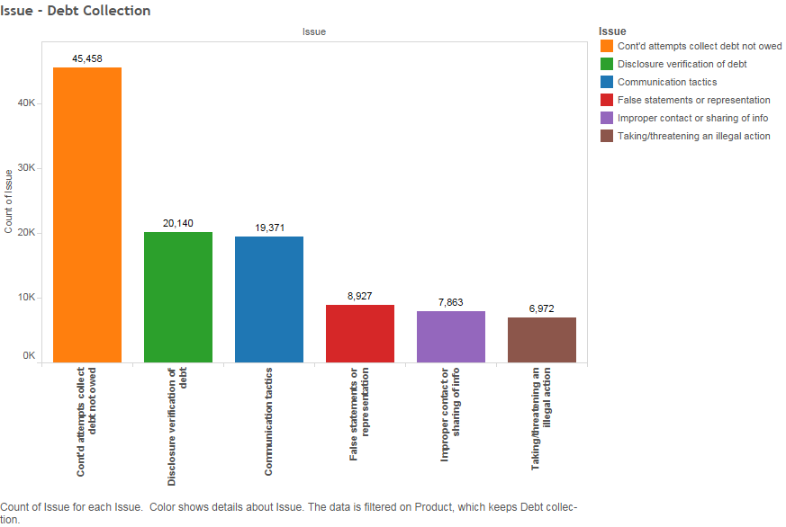
DEBT COLLECTION ISSUES
DROP TABLE IF EXISTS CCIDC;
CREATE TABLE CCIDC AS
SELECT Issue, COUNT(Issue)
FROM CC
WHERE Product = 'Debt collection'
GROUP BY Issue;

Slide 12
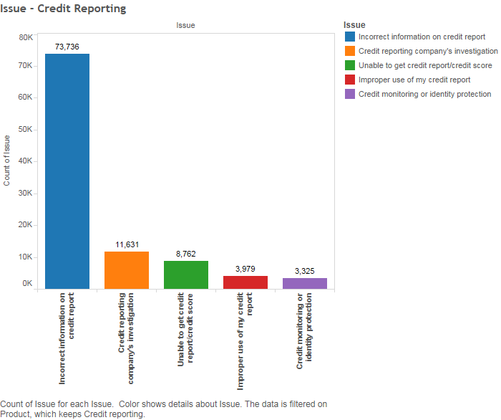
CREDIT REPORTING ISSUES
DROP TABLE IF EXISTS CCICR;
CREATE TABLE CCICR AS
SELECT Issue, COUNT(Issue)
FROM CC
WHERE Product = 'Credit reporting'
GROUP BY Issue;

Slide 13
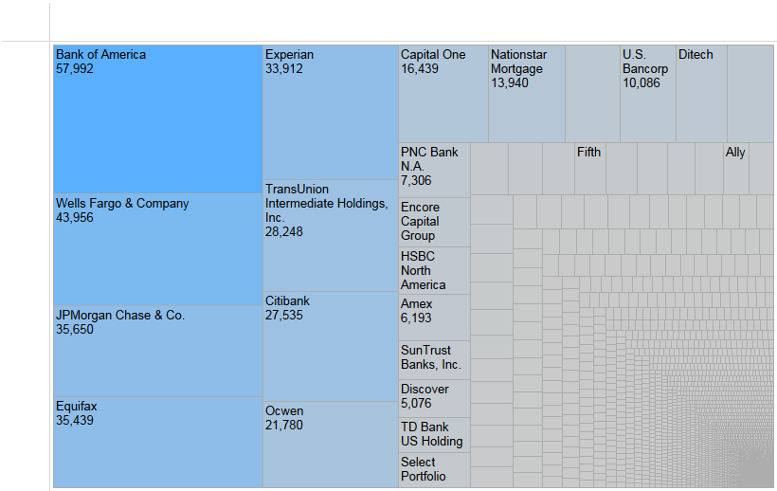
COMPANY -WISE ANALYSIS
DROP TABLE IF EXISTS CCC;
CREATE TABLE CCC AS
SELECT Company, COUNT(Company)
FROM CC
GROUP BY Company;

Slide 14
YEAR-WISE ANALYSIS
DROP TABLE IF EXISTS CCY;
CREATE TABLE CCY AS
SELECT Datereceived, COUNT(Daterecieved)
FROM CC
GROUP BY Daterecieved;

Slide 15
TIMELY RESPONSE
DROP TABLE IF EXISTS CCTR;
CREATE TABLE CCTR AS
SELECT Timelyresponse, COUNT(Timelyresponse)
FROM CC
GROUP BY Timelyresponse;

Slide 16
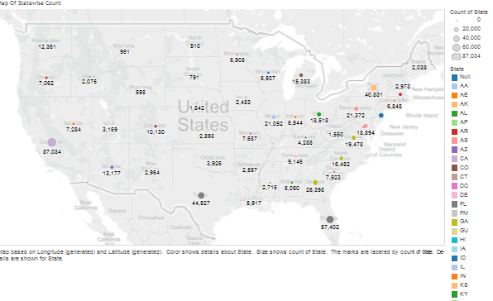

MAXIMUM ISSUES REGISTERED STATEWISE
DROP TABLE IF Exists CCS;
CREATE TABLE CCS AS
SELECT State, COUNT(State)
FROM CC
GROUP BY State;

Slide 17
COMPLAINTS SUBMITTED VIA
DROP TABLE IF Exists CCSV;
CREATE TABLE CCSV AS
SELECT Submittedvia, COUNT(Submittedvia)
FROM CC
GROUP BY Submittedvia;
WEB
REFFERAL
POSTAL MAIL
PHONE
FAX
EMAIL

Slide 18
CONCLUSION
Mortgage product and other mortgage sub-product complaints are maximum in number.
Consumer complaints are increasing year by year.
Maximum complaints were submitted via web.
California has the highest number of complaints.
Most of the complaints are registered with BANK OF AMERICA.

Slide 19
GITHUB AND DATASET DETAILS
https://github.com/khushbudesai/CIS-520/upload/master
https://catalog.data.gov/dataset/consumer-complaint-database

Slide 20
REFERENCES
http://www.consumerfinance.gov/data-research/research-reports/2015-consumer-response-annual-report/
http://www.consumerfinance.gov/data-research/research-reports/semi-annual-report-spring-2016/

Slide 21
THANK YOU!

